Slide 1
The Long Lost Art of Refactoring
Jimmy Bogard

Slide 2


The Long Lost Art of Refactoring
Jimmy Bogard
@jbogard
github.com/jbogard
jimmybogard.com

Slide 3
Me Junk
Independent Consultant
@jbogard
github.com/jbogard
jimmybogard.com

Slide 4


Slide 5
Shoulders of Giants

Slide 6
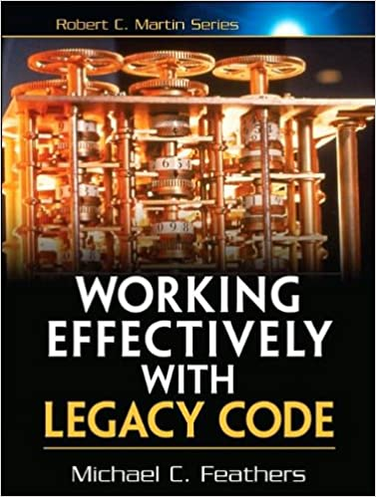
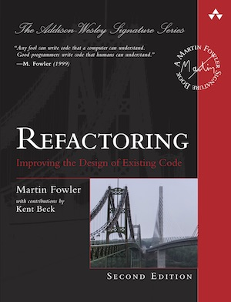
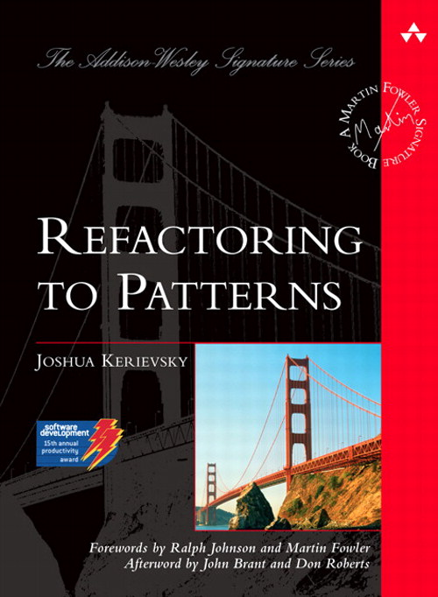

Slide 7
What is Refactoring?

Slide 8
A change made to the internal structure of software to make it easier to understand and cheaper to modify without changing its observable behavior

Slide 9

Law of two hats
Swap back and forth between adding functionality and refactoring roughly 50/50 of the time

Slide 10

Why refactor?

Slide 11

Improve Design

Slide 12

Easier to Understand

Slide 13

Find Bugs

Slide 14

Program Faster

Slide 15

When to refactor?

Slide 16

Feature Prep

Slide 17

Comprehension

Slide 18

Picking Up Litter

Slide 19

Long-Term Changes

Slide 20

During Code Reviews

Slide 21

Problems with Refactoring

Slide 22

Slowing Down Development

Slide 23

Code Ownership

Slide 24

Long-Lived Branches

Slide 25

Bad or No Tests

Slide 26

Legacy Code

Slide 27

Code Smells

Slide 28
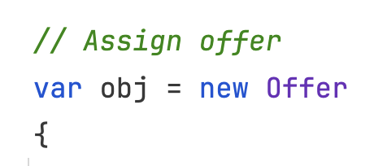
Mysterious Name
Notes:
Change Function Declaration
Rename Variable
Rename Field

Slide 29
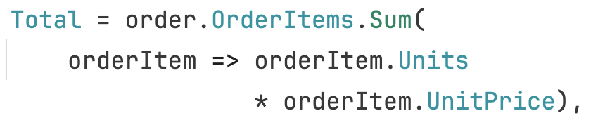
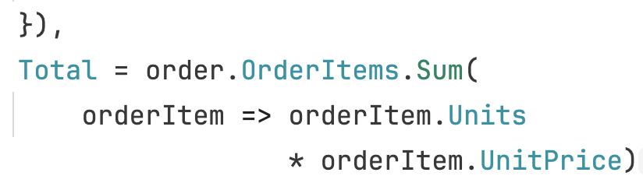
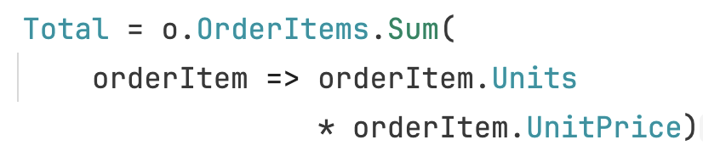
Duplicated Code
Notes:
Extract Function
Slide Statements
Pull Up Method

Slide 30
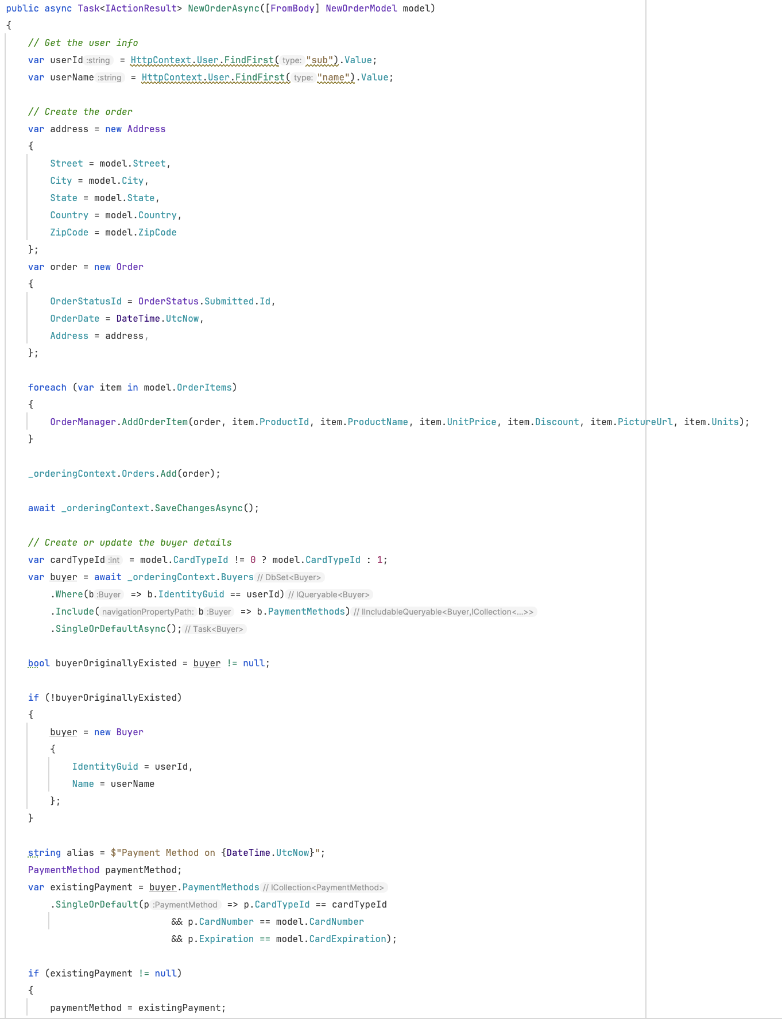
Long Function
Notes:
Extract Function
Replace Temp with Query
Introduce Parameter Object
Preserve Whole Object
Replace Function with Command
Decompose Conditional
Replace Conditional with Polymorphism

Slide 31
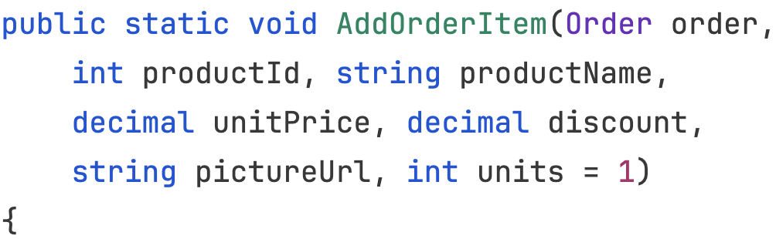
Long Parameter List
Notes:
Replace Parameter with Query
Preserve Whole Object
Introduce Parameter Object
Remove Flag Argument
Combine Functions into Class

Slide 32
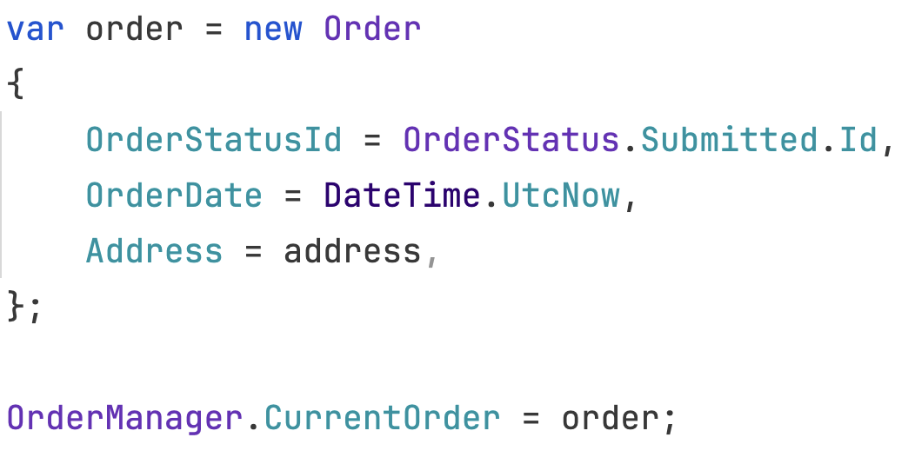
Global Data
Notes:
Encapsulate Variable

Slide 33
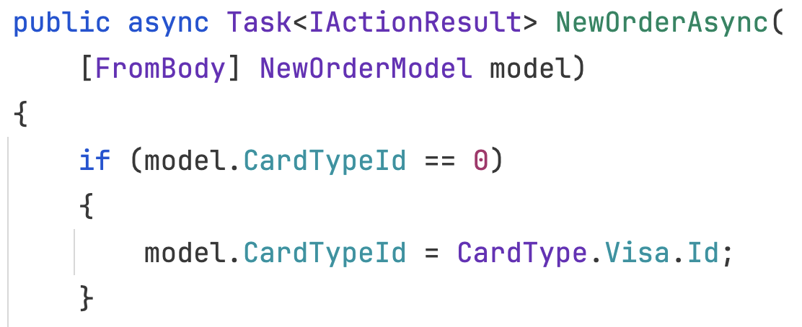
Mutable Data
Notes:
Encapsulate Variable
Split Variable
Separate Query from Modifier
Remove Setter Method
Replaced Derived Variable with Query
Combine Functions into Class
Combine Functions into Transform
Change Reference to Value

Slide 34
Divergent Change
Notes:
Split Phase
Move Function
Extract Function
Extract Class

Slide 35
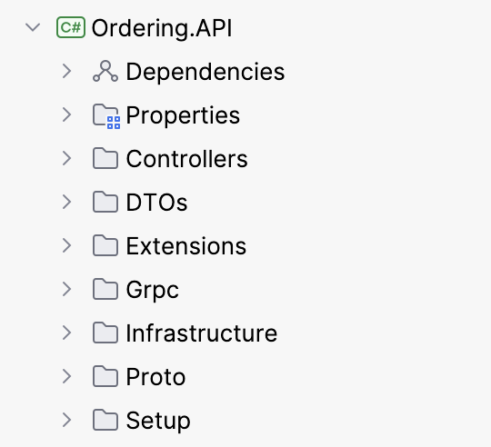
Shotgun Surgery
Notes:
Move Function
Move Field
Combine Functions into Class
Combine Functions into Transform
Split Phase
Inline Function
Inline Class

Slide 36
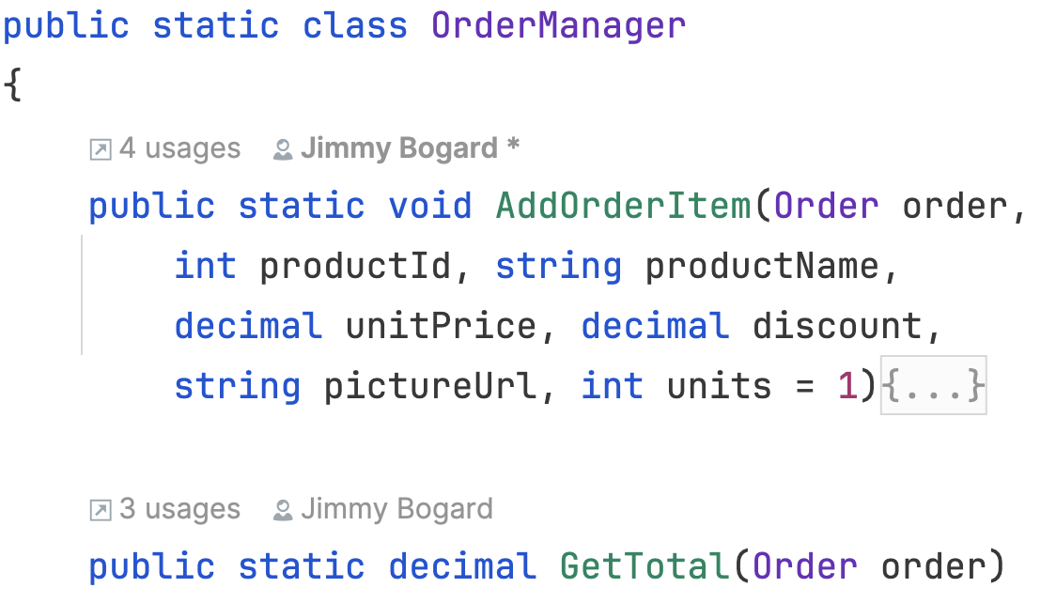
Feature Envy
Notes:
Extract Function
Move Function

Slide 37
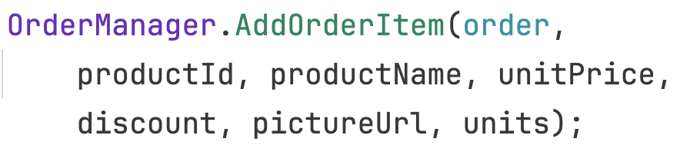
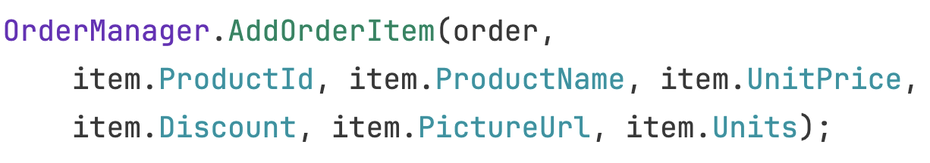
Data Clumps
Notes:
Extract Class
Introduce Parameter Object
Preserve Whole Object

Slide 38
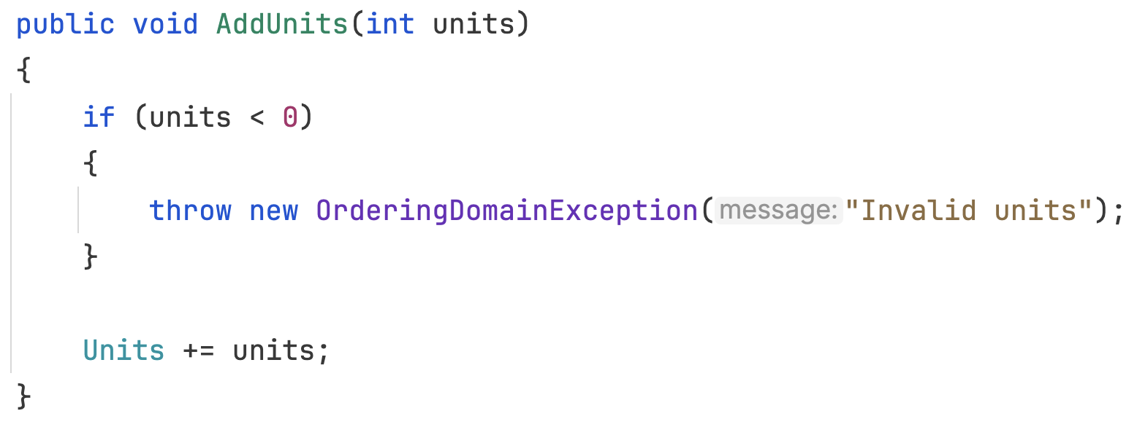
Primitive Obsession
Notes:
Replace Primitive with Object
Replace Type Code with Subclasses
Replace Conditional with Polymorphism

Slide 39
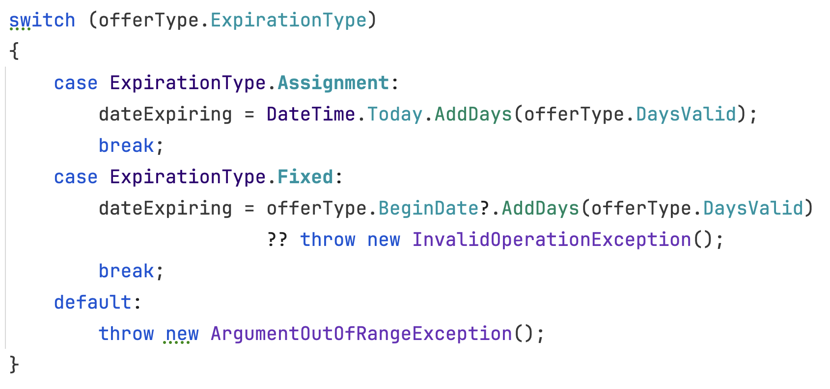
Repeated Switches
Notes:
Replace Conditionals with Polymorphism

Slide 40
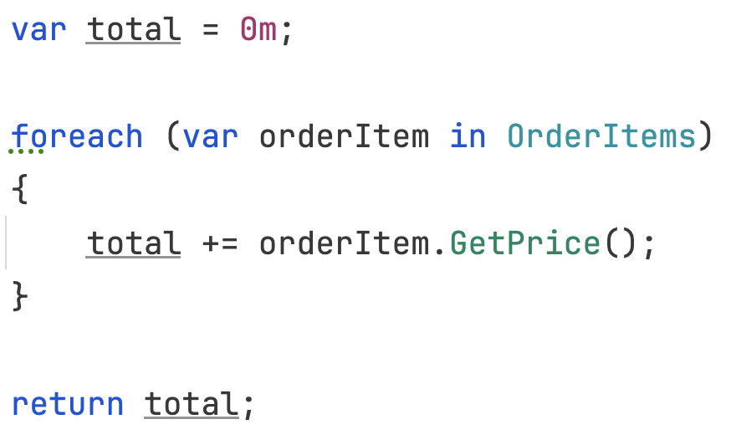
Loops
Notes:
Replace Loop with Pipeline (LINQ)

Slide 41
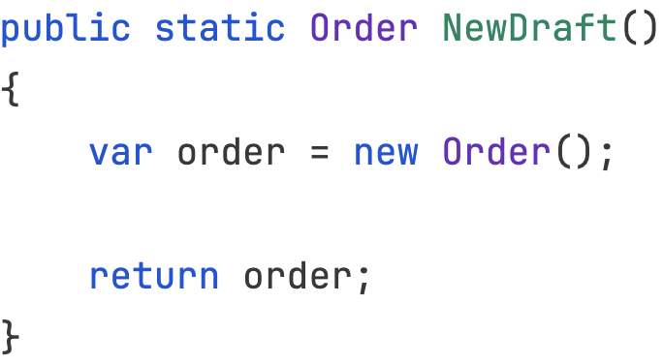
Lazy Element
Notes:
Inline Function
Inline Class
Collapse Hierarchy

Slide 42
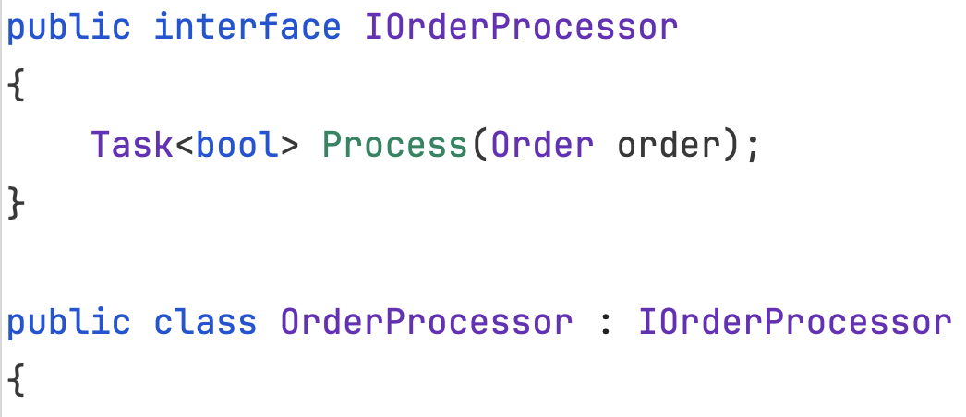
Speculative Generality
Notes:
Collapse Hierarchy
Inline Function
Inline Class
Change Function Declaration
Remove Dead Code

Slide 43
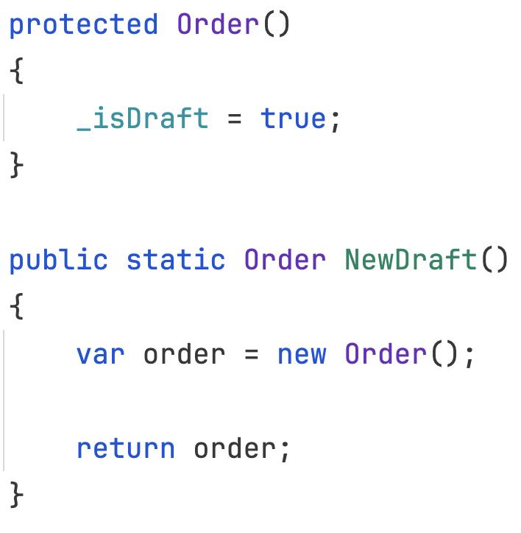
Temporary Field
Notes:
Extract Class
Move Function
Introduce Special Case

Slide 44
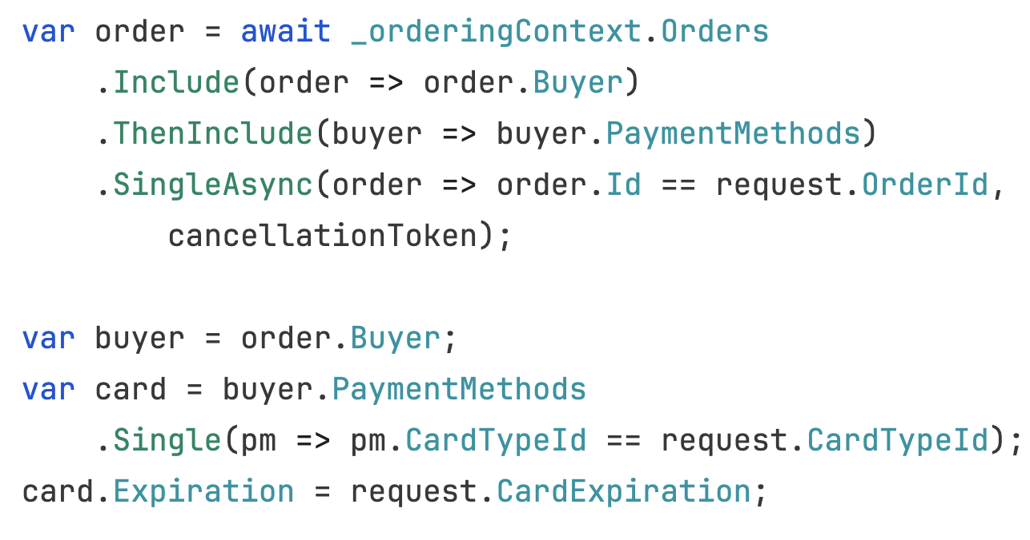
Message Chains
Notes:
Hide Delegate
Extract Function
Move Function

Slide 45
Middleman
Notes:
Remove Middleman
Inline Function

Slide 46
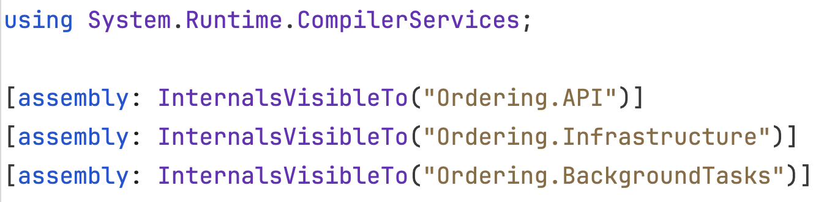
Insider Trading
Notes:
Move Function
Move Field
Hide Delegate
Replace Subclass with Delegate
Replace Superclass with Delegate

Slide 47
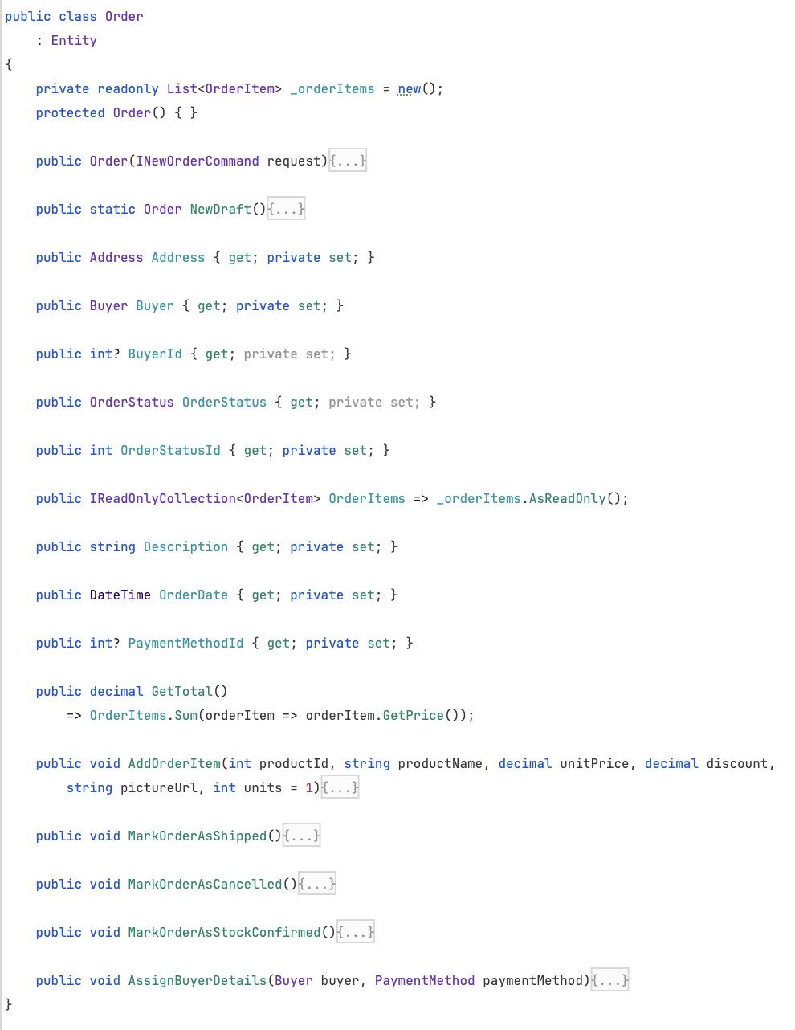
Large Class
Notes:
Extract Class
Extract Superclass
Replace Type Code with Subclasses

Slide 48
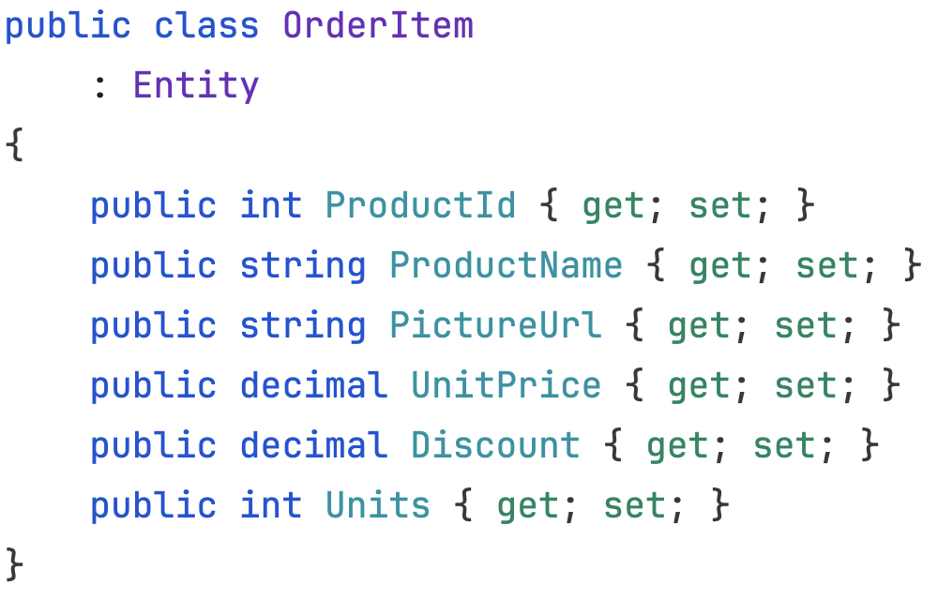
Data Class
Notes:
Encapsulate Record
Remove Setting Method
Move Function
Extract Function
Split Phase

Slide 49

Example

Slide 50
The Long Lost Art of Refactoring
Jimmy Bogard
@jbogard
github.com/jbogard
jimmybogard.com
github.com/jbogard/presentations

Slide 52
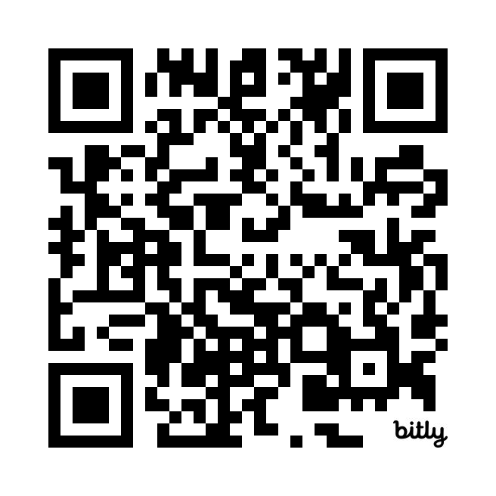
The Long Lost Art of Refactoring
DDD with Vertical Slice Architecture Training
Oct 21st-23rd in Munich
Dec 10th-12th in Milan
20% discount code Community20

